Slide 1

汇报人：孙蕗 宁可心
success

Slide 2
Part 0 1

Slide 3
Who do you think is succesesful ?
maybe
your parents?
an idol?
business elites?
or else?

Slide 4

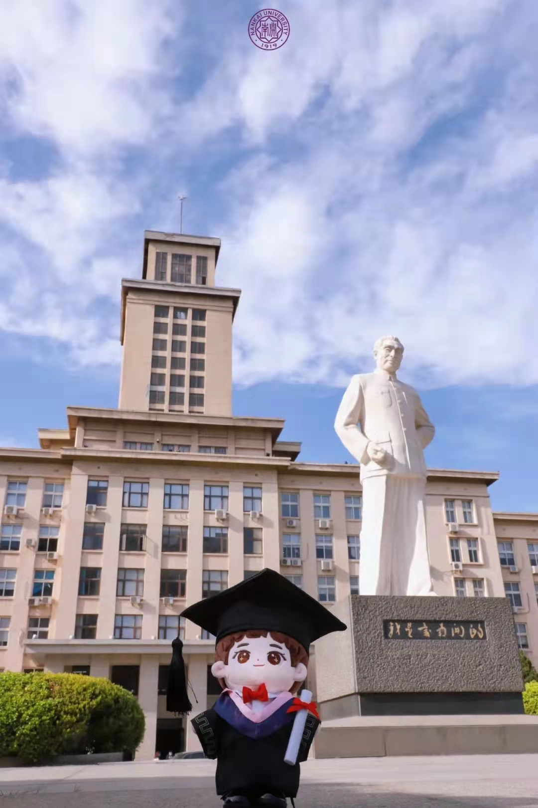
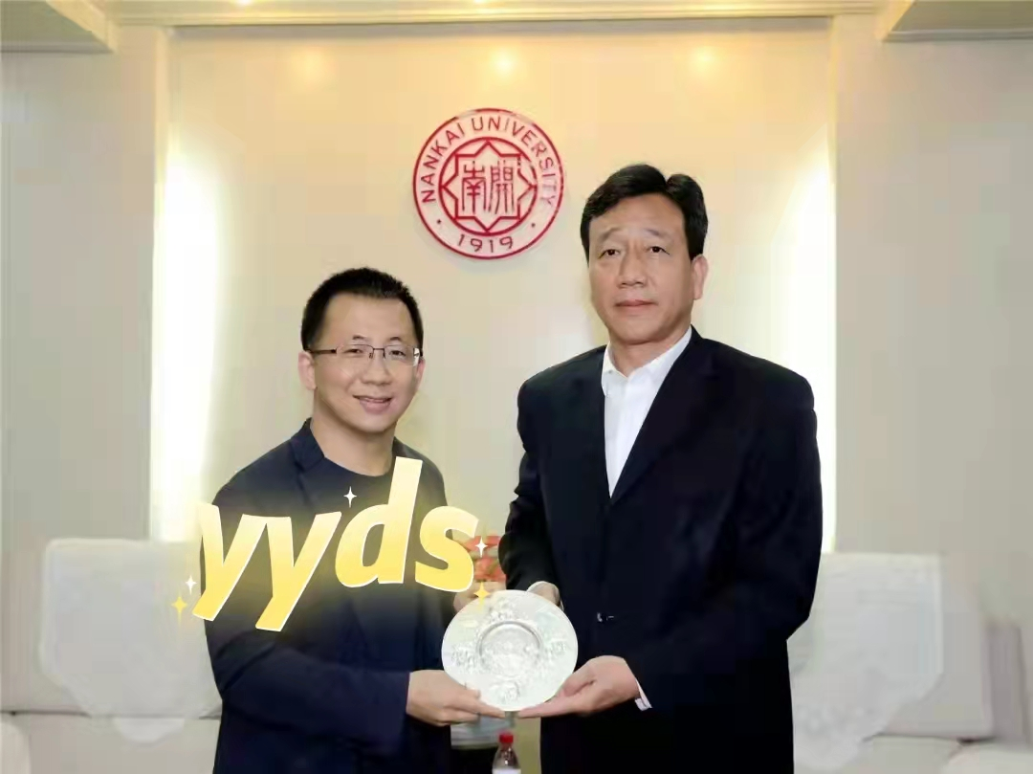
P
r
e
m
i
e
r
Z
h
o
u
Zhang Yiming

Slide 5



-How to succeed?
-Stay hungry ,stay young.
--Zhang Yiming

Slide 6
stay hungry
stay young
hunger for the betterment
not rest satisfied with the present
dare to adhere to your lofty ambitions
don't set rules and regulations
don't compromise and don't be sophisticated
never reach the ceiling

Slide 7
Part 0 2

Slide 8

find your soul mate in your dream
cooking alone for the first time
D
B
C
A
ascend the rank of King of glory
from climb to walk

Slide 9


Now,share a successful experience
maybe ……
maybe……
the plant grows well
the cooking is delicious
learn a skill
……
finish your homework before ddl
run five kilometers in Chuanggao App a day
make a organised plan
……

Slide 10
Part 0 3

Slide 11


what would you do if you were successful in the future？
How will we treat the people we love, and the people who love us？
How to repay the parents who have endured hardships and silently contributed to our success？
How to repay the alma mater who educated us to become talents and sent us to a new level of life?
Even the land that gave birth to us?
How to repay the cost of training us from our great China?

Slide 12

before ending …………
If you wish to succeed, you should use perdistence as your good friend, experiece as your reference, prudence as your brother and hope as your sentry.
--Edison

Slide 13
Thanks for listening

